Slide 1
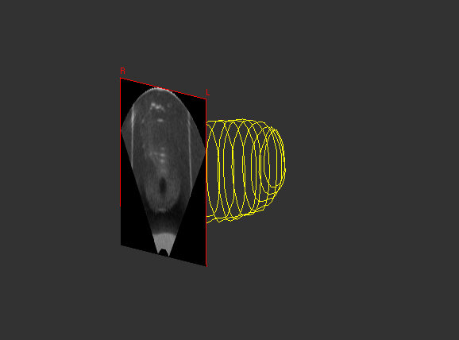
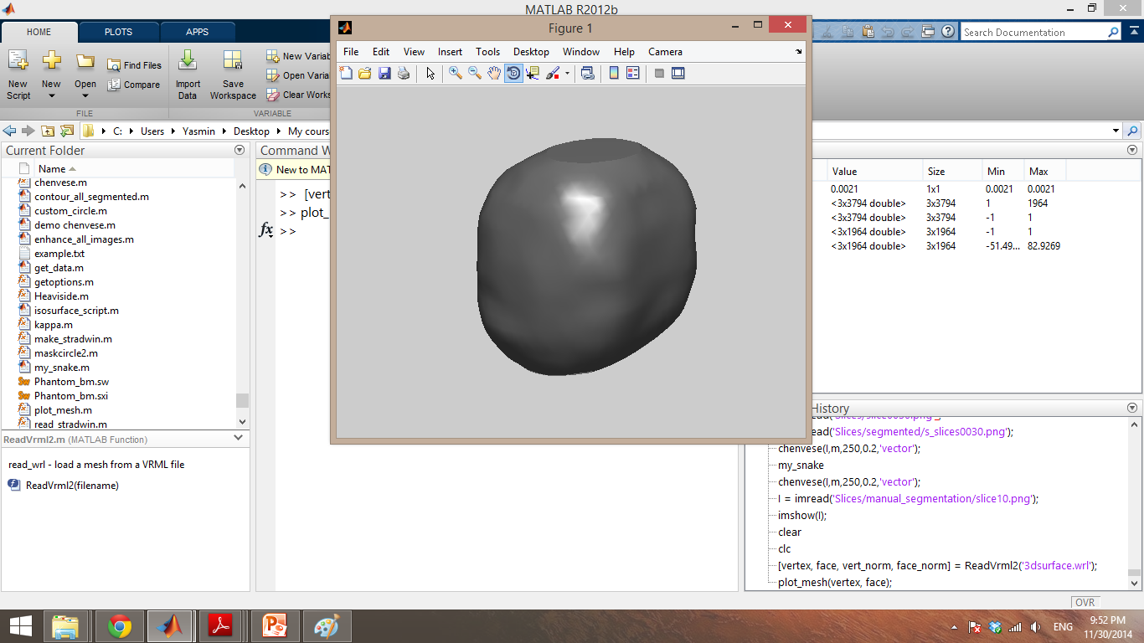
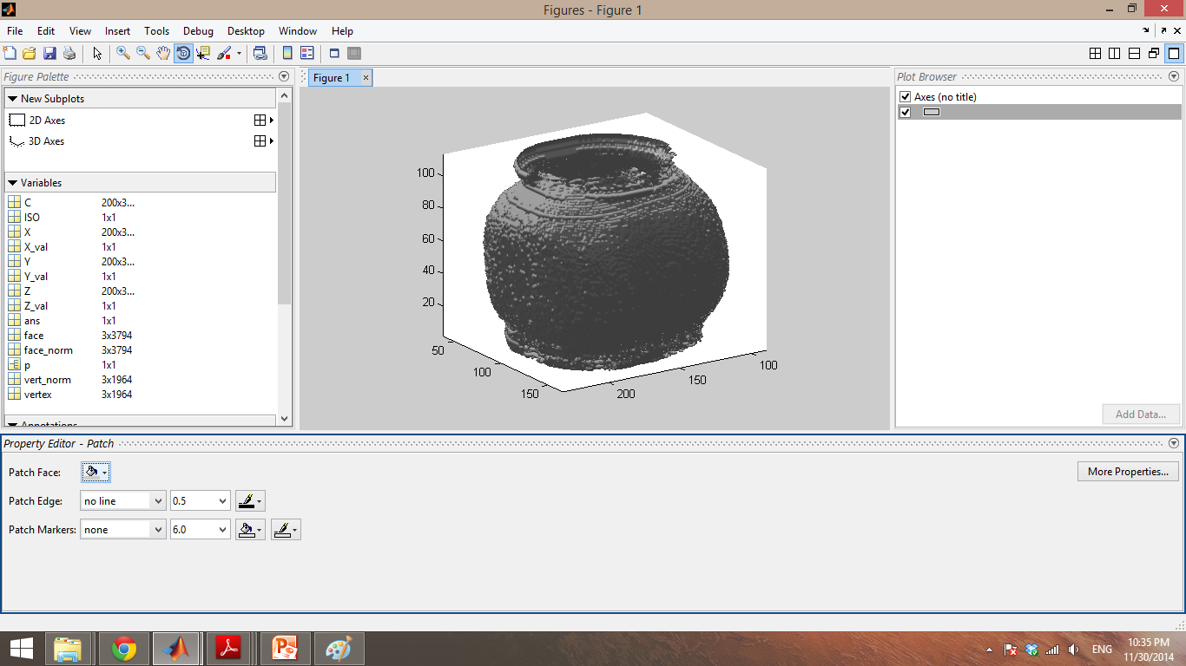
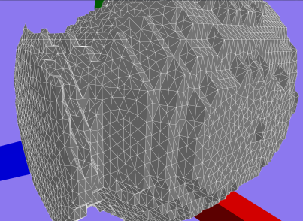
Surface Construction from 3D Ultrasound Data
CPSC524: Computer Graphics Modelling
Yasmin Halwani
Sara Sheikholeslami
University of British Columbia
Dec. 15, 2014

Slide 2
Outline
Introduction
Data Generation
Mesh Construction: Marching Cubes
Contour Denoising
Remeshing
Conclusion

Slide 3
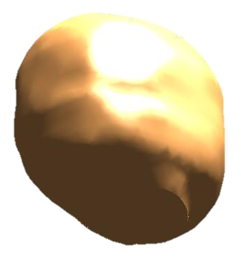
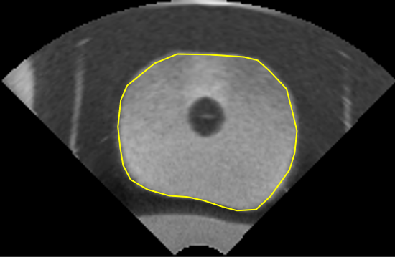
Project Goal

Slide 4
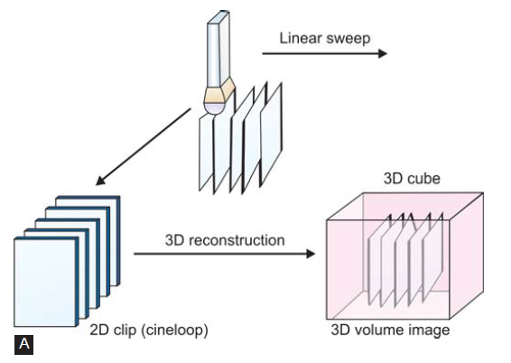
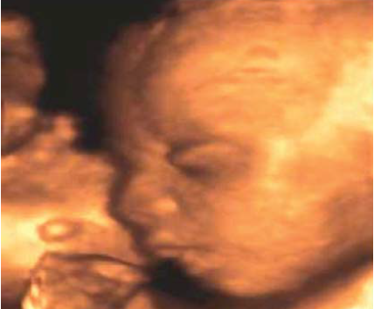
Introduction
3D US Acquisition
3D US Data Visualization
Segmentation
Surface Construction
Manual
Automatic
3DUS Image of a Fetus *
3DUS Data Acquisition Process *
* Image Source: L.B. Cruz, “Basics on 3D Ultrasound,” Jaypee Journals, vol. 2, no. 4, 2008, pp. 83.

Slide 5
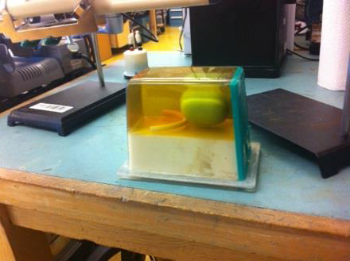
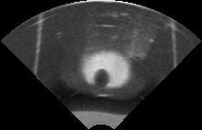


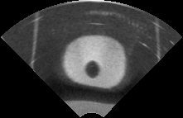
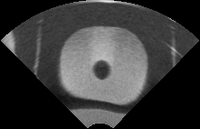
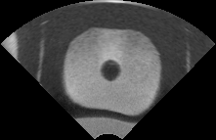
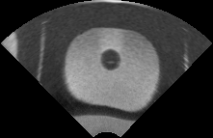
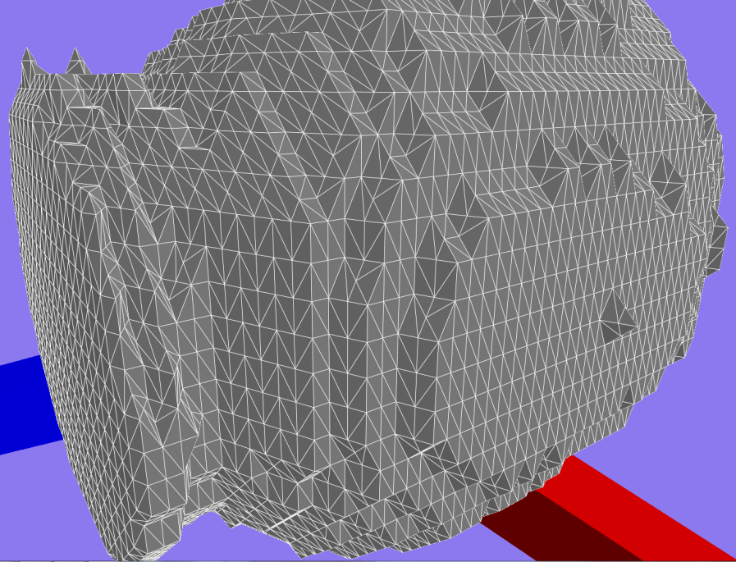

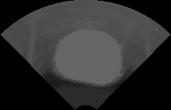
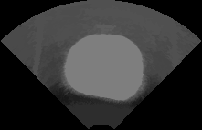

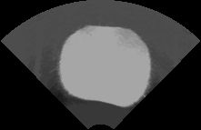


Overall Steps
1. Data Acquisition
3. Basic Contour De-noising
Prostate Phantom
at RCL
Prostate Phantom
3D US Data
2. Image Segmentation
4. Mesh Construction
5. Re-meshing
Automatic Segmentation

Slide 6

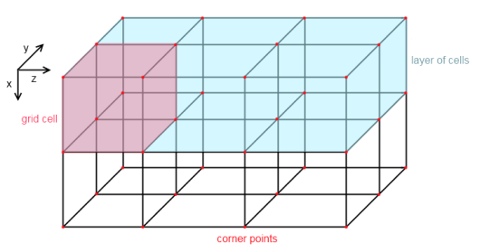
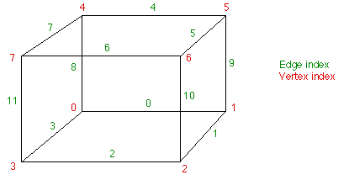
Marching Cubes
Isovalue = 255
Mesh Grid
CubeIndex = v₇v₆v₅v₄v₃v₂v₁v₀
Edge Table
Triangle Table

Slide 7
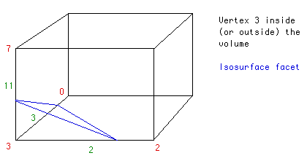
Marching Cubes
edgeTable[256]={ 0x0 , 0x109, 0x203, 0x30a, 0x406, 0x50f, 0x605, 0x70c, 0x80c, 0x905, 0xa0f, 0xb06, 0xc0a, 0xd03, 0xe09, 0xf00, 0x190, 0x99 , 0x393, 0x29a,….}
12-bit elements: determines which edges contain a triangle vertex
triTable[256][16] =
{{-1, -1, -1, -1, -1, -1, -1, -1, -1, -1, -1, -1, -1, -1, -1, -1},
{0, 8, 3, -1, -1, -1, -1, -1, -1, -1, -1, -1, -1, -1, -1, -1},
{0, 1, 9, -1, -1, -1, -1, -1, -1, -1, -1, -1, -1, -1, -1, -1},
….}
Determines the triangles orientation within a cube

Slide 8
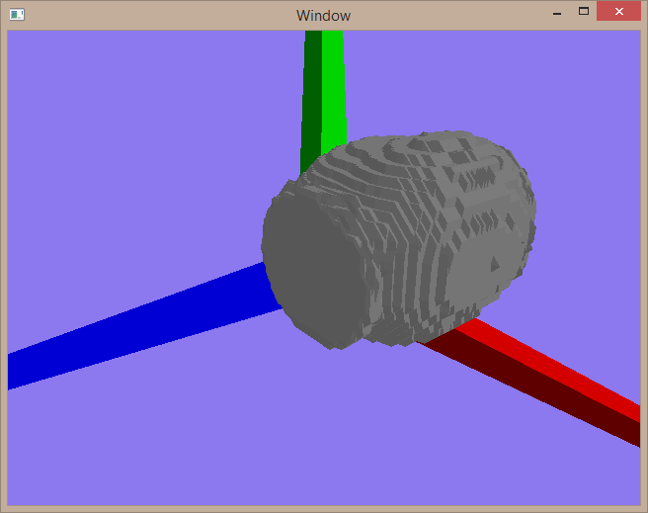
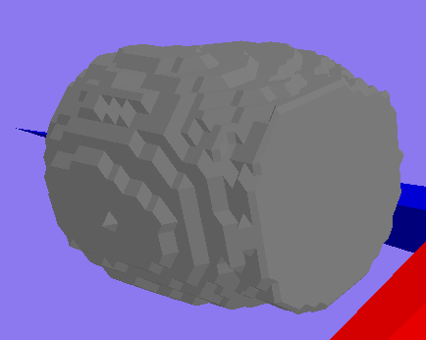
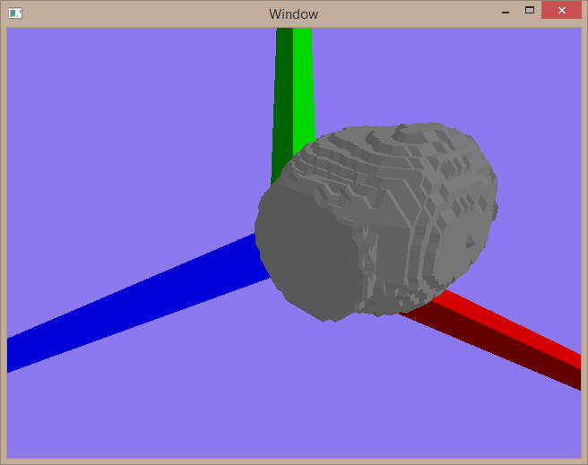
Marching Cubes Resolution Effect
113 Slices
30 Slices
56 Slices

Slide 9
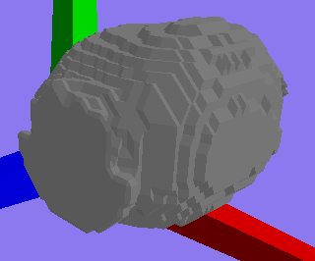
Marching Cubes Output (56 Slices)
Noisy Contours
Filtered Contours
Slice # 6

Slide 10
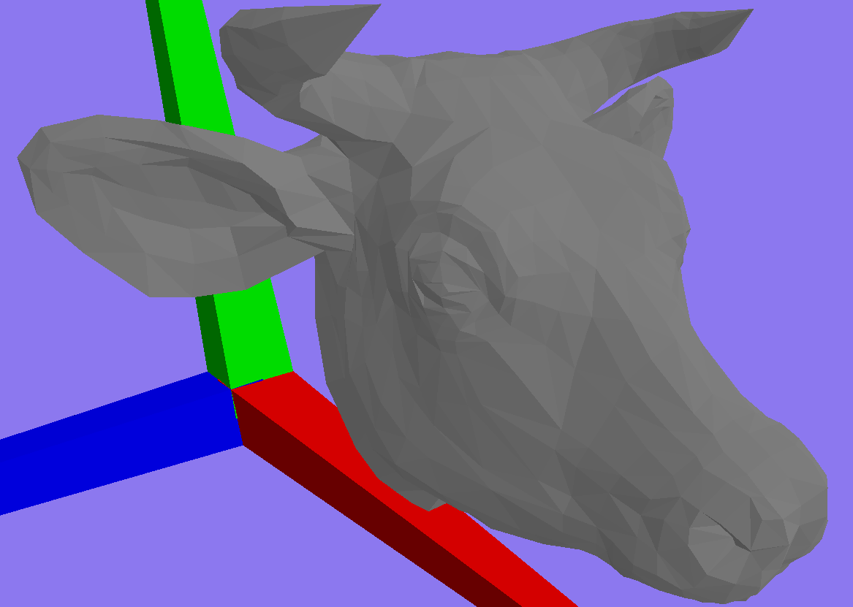
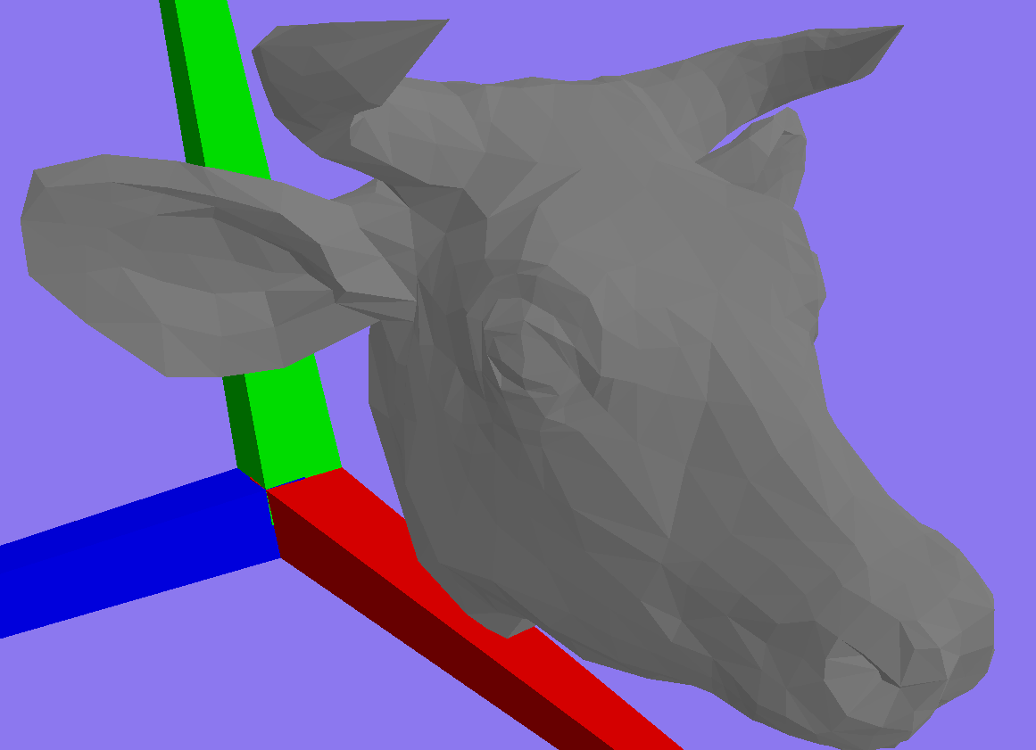
Adaptive Re-meshing
Modify a given a 3D mesh to get a
Better mesh
Preserve the overall geometry
Use a sequence of local operations
Original
After 7 iterations

Slide 11
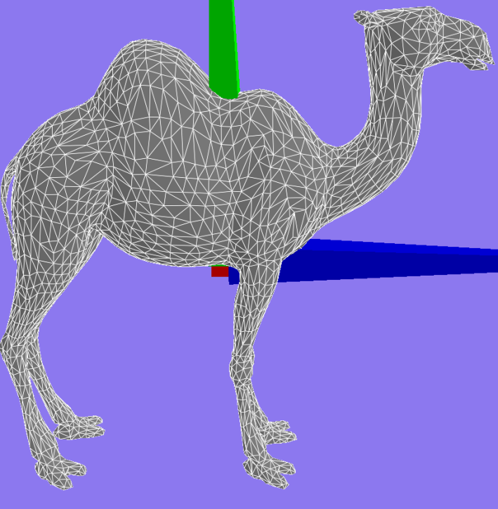
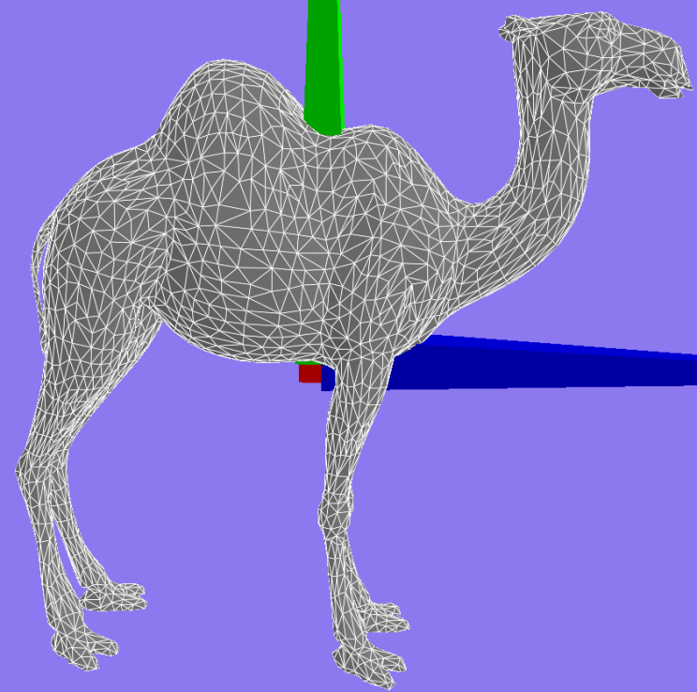
Adaptive Re-meshing
Mesh Refinement:
If an edge is longer than a set threshold, split it by adding an extra vertex
Original
One round of Refinement

Slide 12
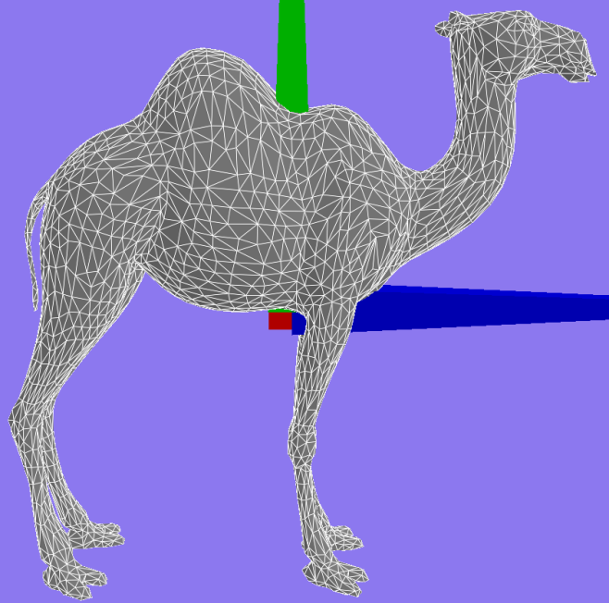
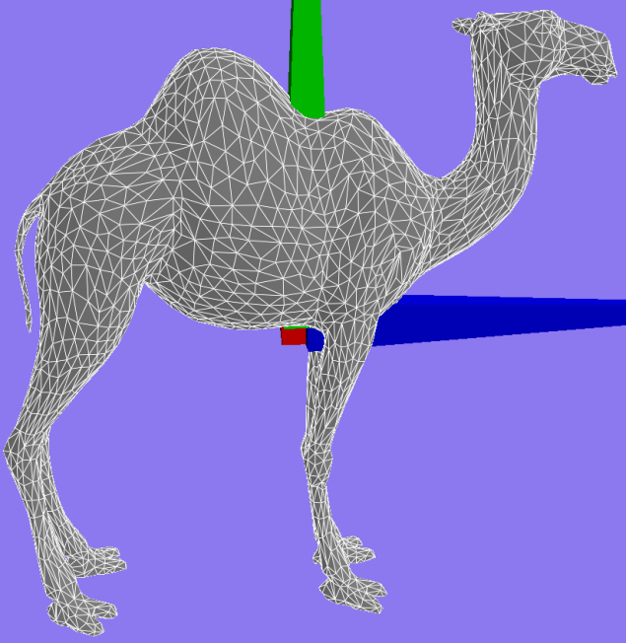
Adaptive Re-meshing
(2) Mesh Smoothing
Move vertices ON surface to improve sizing/quality
Normal error: The difference between the original vertex normals
Original
One round of Smoothing

Slide 13
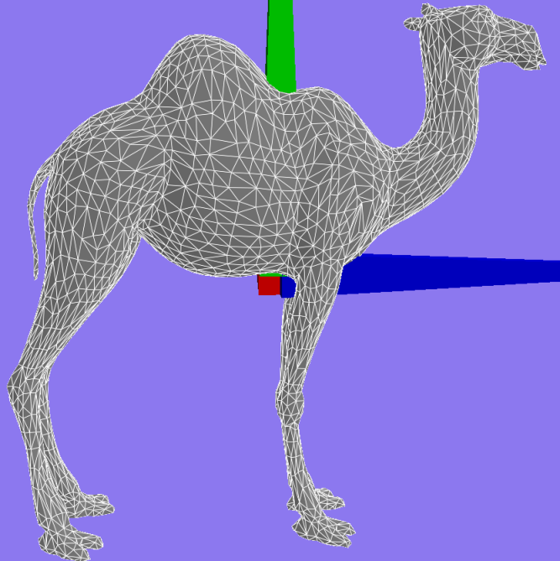
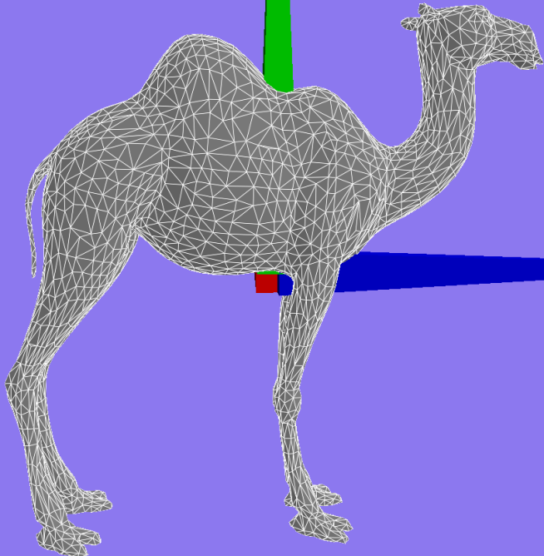
Adaptive Re-meshing
(3) Edge Flip
Given 2 neighboring triangles, flip one diagonal if longer than the other
Smoothness Error: Difference between the current face normal, and the original vertex normals
Original
One round of Edge-Flip

Slide 14


Results
The mesh on the surface looks better
But the general geometry hasn’t changed!
Before
After

Slide 15
Results Analysis
Re-meshing makes the mesh triangles better, but preserves the geometry
The noise in marching cubes distorts the general geometry
Contour de-noising doesn’t solve the problems (makes it better, but doesn’t remove the steps)
Solution: mesh de-noising

Slide 16
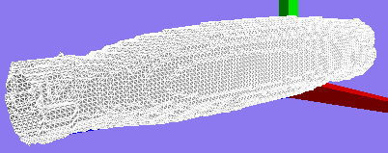
Limitations
Marching Cubes:
Spacing should be manually set (z-axis)
Increasing resolution increases noise
Requires extensive mesh de-noising
Re-meshing
Hard to find good thresholds
The number of Iterations and the sequence of local operations

Slide 17
Resources and Tools
All phantom 3DUS images are obtained from Robotics and Control Lab, UBC
Chan Vese Active Contours without edges: MATLAB code written by Yue Wu, 2009

Slide 18
Discussion
☺

Slide 19
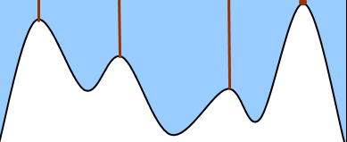
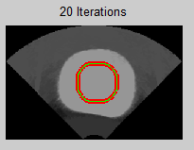
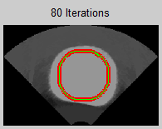
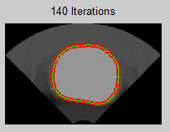

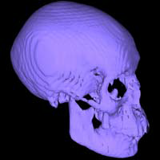
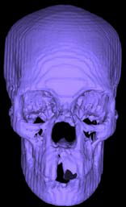
Segmentation & Construction Methods Used
Image Segmentation
Edge-based segmentation: Marker-Controlled Watershed Method
Contour Extraction
Snakes/Active Contours
Watershed segmentation concept*
Surface Construction
Marching Cubes Based on iso-surface value = 255
An example of marching cubes algorithm output**
* Image Source: Y.-H. Wang, “Tutorial: Image Segmentation,” National Taiwan University, Taipei, 2010, pp. 1-36.
** Image Source: Lecture slides on Marching Cubes from CPSC524 - UBC

Slide 20
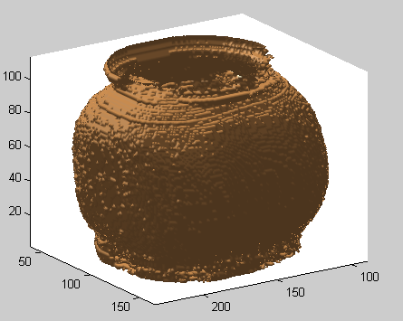
Results and analysis
Stradwin Output (Manual Seg.)
MATLAB Output (Automatic Seg.)
Advantages:
1. Smooth surface
2. Accurate data (due to manual segmentation)
Advantage:
1. Automatic / Fast
Disadvantage:
1. noisy mesh
(due to noisy contours +
marching cubes)
Disadvantages:
1. Manual
2. Possible loss of details (refer to figure above)

